Slide 1
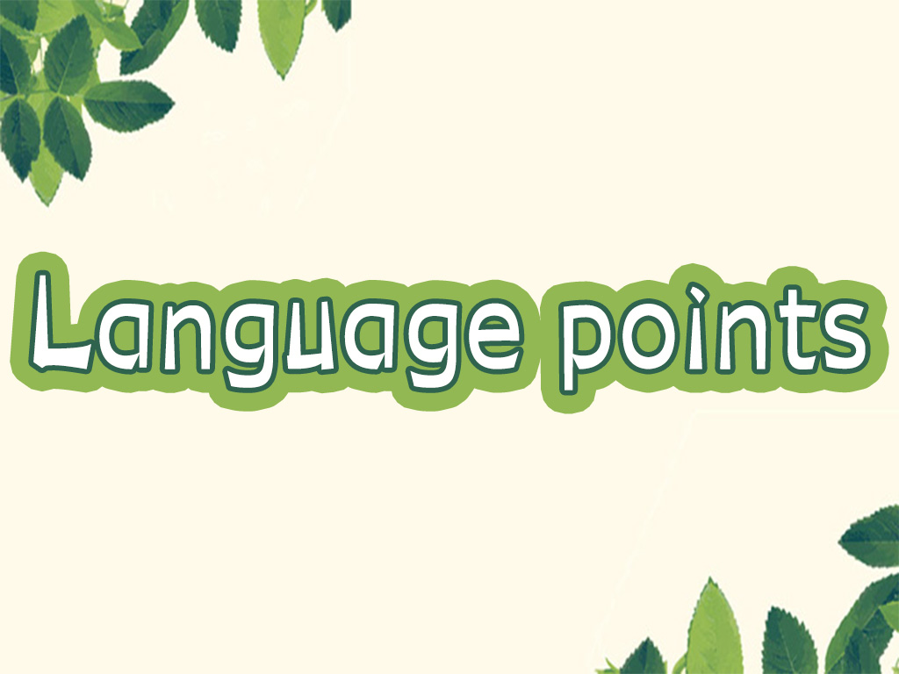

Slide 2

1. Without a fin, a shark can no longer swim and slowly dies.
没有鱼鳍，鲨鱼不能再游泳，然后慢慢死去。
no longer = not…any longer/ not… any more “不再”， 但它们侧重的方面不同。

Slide 3
no longer, not…any longer侧重时间
e.g. Mr. Brown no longer works here.
= Mr. Brown doesn’t work here any longer.
布朗先生不再在这工作了。
not ... any anymore侧重程度和数量
e.g. You can’t drink any more.
你不能再喝了。（喝酒的量到了一定的
程度，不能再继续喝下去了。）

Slide 4
【语境应用】改为同义句。
Joe no longer likes dancing.
Joe doesn’t like dancing any longer.

Slide 5
2. This method is not only cruel, but also
harmful to the environment.
这种方法不但残忍而且对环境有害。
not only…but also… “不仅……而且……”
连接两个表示并列关系的成分，着重强调后者，其中的also有时可以省略。

Slide 6
not only置于句首时，常用倒装语序。
not only... but also...连接两个主语时，谓语动词须与后面那个主语在人称和数上保持一致。
e.g. She not only plays well, but also
writes music.
Not only does my sister sing well, but she
dances well.
Not only the students but also the
teacher is working hard.

Slide 7
【语境应用】同义句转换，每空一词。
1) She and I have already been to Beijing.
____ ____ she ____ ____ I have already been
to Beijing.
2) He likes to swim and he wants to teach the
kids to swim, too.
Not only ____ ____ ____ to swim, ____ he
wants to teach the kids to swim.
Not only but also
does he like
but

Slide 8
3) The twins were late this morning. Sam
was late this morning, too.
Not only the twins ____ ____ Sam ____
late this morning.
____ ____ Sam but also the twins _____ late
this morning.
but also
was
Not only
were

Slide 9
be harmful to 对……有害
【语境应用】翻译句子。
1) 吸烟有害健康。
Smoking is harmful to the health.
2) 手机玩太多对眼睛有害。
Playing mobile phone much is harmful
to your eyes.

Slide 10
3. Sharks are at the top of the food chain in the ocean’s ecosystem.
鲨鱼位于海洋生物系统食物链的顶部。
at the top of 在……最高地位; 用最高[最大]的(速度, 声音等)
e.g. He shouted at the top of his voice in
order that he might be heard.
他尽力大声叫喊, 为了别人能听见。

Slide 11
【语境应用】翻译句子。
Mary is at the top of her class in English.
___________________________________
玛丽的英语是班上第一名。

Slide 12
4. If their numbers drop too low, it will
bring danger to all ocean life.
如果它们的数目降至过低，会给所有海洋生物带来危险。
此句复数形式的numbers表达全海洋中鲨鱼的总量。

Slide 13
当表示数值的高或低时，number要用
high或low修饰。常与number搭配的动词有
grow, fall等。
e.g. In that country, the number of children
going to school is higher in cities than in
towns and villages.
在那个国家，城市儿童入学人数比乡镇及
农村要高。

Slide 14
In recent years, the number of families
that own cars has been growing quickly.
近几年来拥有轿车的家庭数量增长很快。

Slide 15


